Slide 1


Slide 2



Meeting/Lecture Summarisation & Question Answering Systems
Two NLP projects: LSTM-based abstractive summarisation and T5 Transformer question answering
Second Year | Project Presentation
Department of Computer Science and Engineering (AI & ML) | K.R. Mangalam University | Academic Year 2026–2027
NAME | ROLL NO.
Piyush | 2401730018
Faculty Mentor: Mr. Aditya Chauhan

Slide 3
Problem Statement & Objectives
Project 1: Meeting / Lecture Summarisation
Project 2: Question Answering (T5)
Problem Statement
Meetings, lectures and interviews generate large volumes of conversational text. Reviewing them manually is time-consuming, and hand-written notes often omit key decisions and details.
Proposed Solution
An abstractive summarisation system that converts lengthy dialogue into concise, readable summaries using a Seq2Seq LSTM model with an Attention mechanism.
Objectives
Generate concise, abstractive summaries of long conversations
Clean and normalise unstructured conversational text
Evaluate summary quality using BLEU and ROUGE
Reduce the time and effort spent reviewing long discussions
Problem Statement
Conventional information retrieval returns documents or passages rather than direct answers, forcing users to search lengthy text manually.
Proposed Solution
A generative Question Answering system that fine-tunes the pre-trained T5-Base Transformer to produce concise answers from a question and its supporting context.
Objectives
Fine-tune pre-trained T5-Base on the SQuAD dataset
Apply text preprocessing to improve input quality
Assess the model using training and test loss
Lay the groundwork for intelligent retrieval applications
3

Slide 4
Introduction & Real-World Applications
Summarisation Model (Abstractive)
Produces a condensed version of a conversation by generating new sentences rather than copying existing ones. Implemented as an Encoder LSTM, Attention and Decoder network in TensorFlow / Keras.
Domain | Summarisation | Question Answering
Education | Summarise lecture recordings | Answer from study materials
Meetings & business | Record decisions and key discussions | Automate customer-support replies
Healthcare | Summarise doctor–patient consultations | Retrieve facts from medical documents
Research | Summarise long discussions | Find specifics in research papers
Interviews & documents | Short interview summaries | Extract info from lengthy documents
Question Answering Model (T5)
T5 (Text-to-Text Transfer Transformer) frames every task as text-to-text. The input is a question with its context; the output is the answer. Implemented with PyTorch Lightning.
4

Slide 5
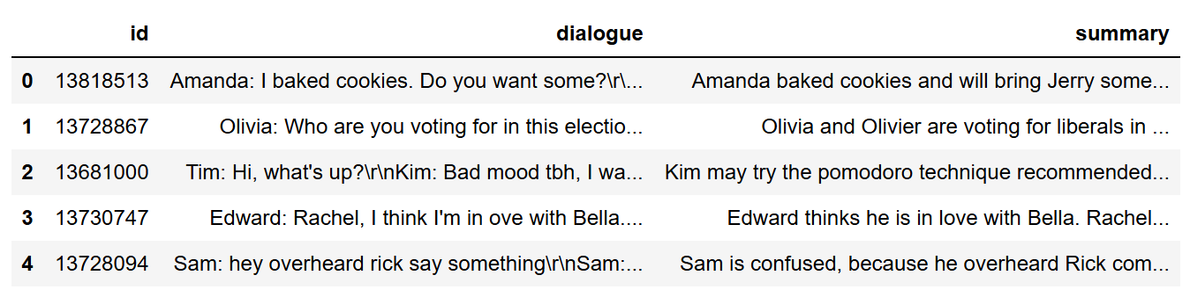
Dataset Description
Summarisation Dataset
Question Answering Dataset · SQuAD
Attribute | Description
Fields | Dialogue, Summary + lengths
Type | Multi-speaker conversation
Reference | Human-written summaries
Source | Similar to SAMSum (to be confirmed)
Split | 70% train / 30% test
Parameter | Description
Dataset | Stanford QA Dataset (SQuAD)
Source | Hugging Face Datasets, train split
Records | 5,000 selected
Features | Question + context → answer
Split | 3,800 / 200 / 1,000
NOTEBOOK OUTPUT · LOADED DATASET PREVIEW
Dialogue, summary and derived length columns as loaded in the notebook.
5

Slide 6
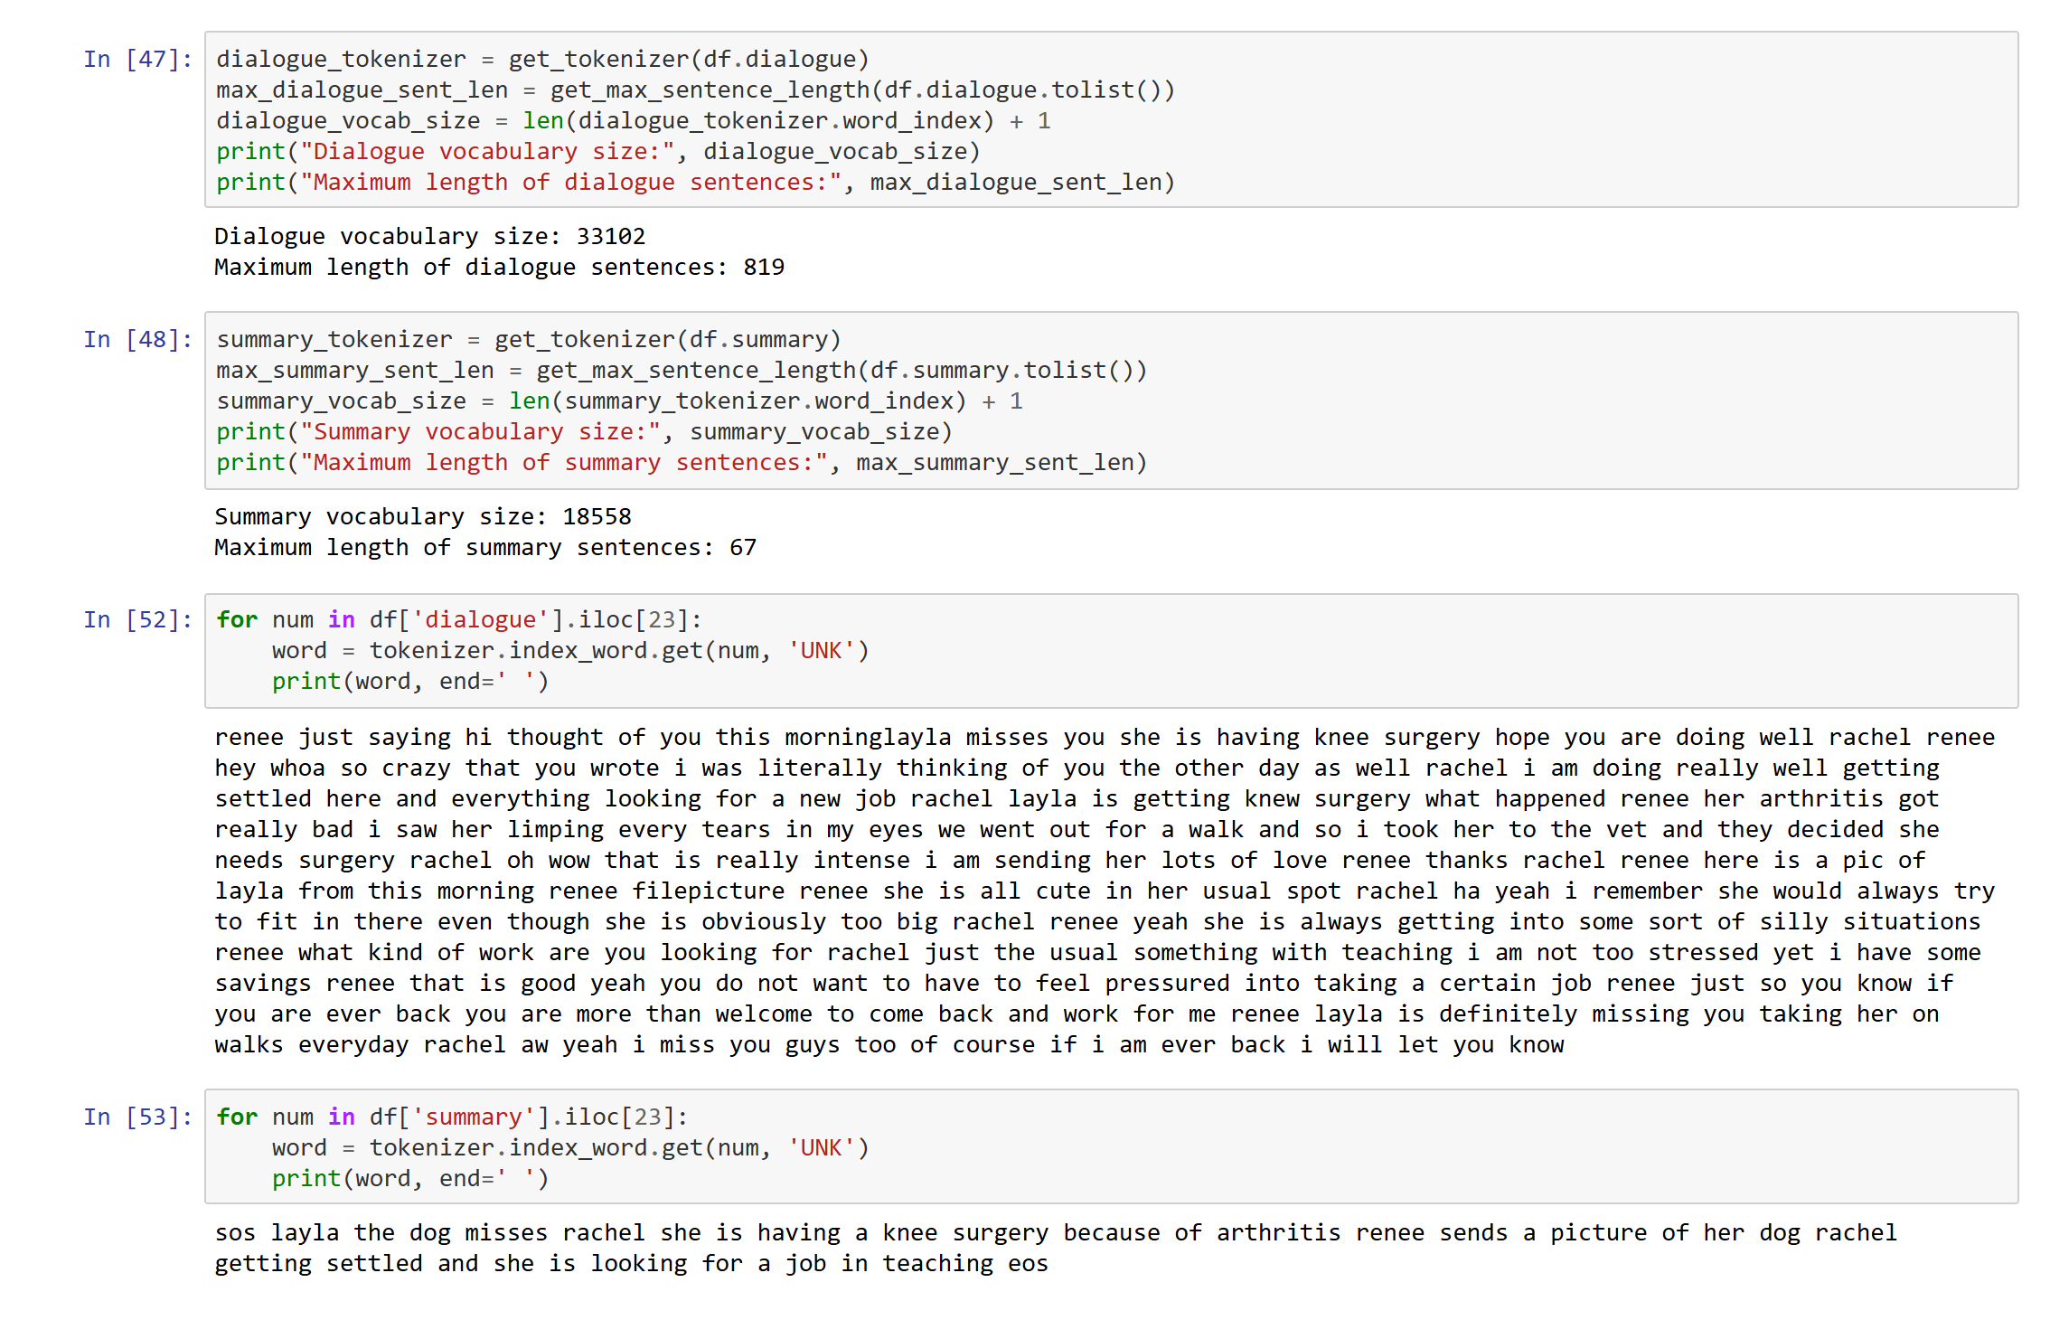
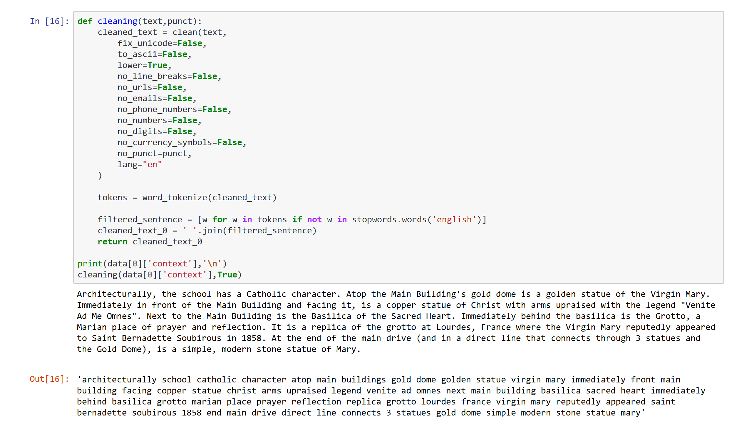
Data Preprocessing
Summarisation Pipeline · NOTEBOOK OUTPUT
Question Answering Pipeline · NOTEBOOK OUTPUT
01 Raw SQuAD records
02 CleanText cleaning and lowercasing
03 NLTK word tokenisation
04 English stopword removal
05 Question, context, answer → Pandas DataFrame
06 T5Tokenizer: 512 input / 64 output tokens
01 Raw dialogue text
02 Lowercase; strip URLs, emojis and special characters
03 Expand chat words and contractions
04 Add <sos> and <eos> summary markers
05 Tokenise and pad to 300 input / 50 summary tokens
24,000-word vocabulary
300 input / 50 output tokens
T5 sentence-piece tokenizer
512 input / 64 output tokens · attention masks
6

Slide 7
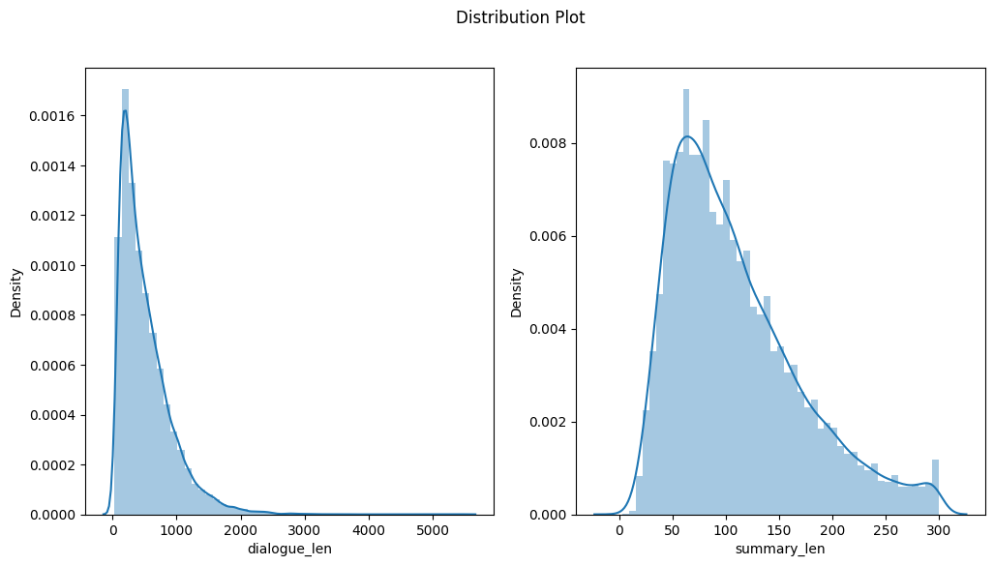
EDA & Feature Engineering
Summarisation · Exploratory Data Analysis
Feature engineering
NOTEBOOK OUTPUT · LENGTH DISTRIBUTIONS
Parameter | Summarisation | QA (T5)
Tokenizer | Keras, 24,000 vocab | T5Tokenizer
Max input | 300 tokens | 512 tokens
Max output | 50 tokens | 64 tokens
Embedding | 300-dim | T5 built-in
Padding | Fixed length | Max length + truncation
Special | <sos> / <eos> | Attention mask
Dialogue and summary token counts across the corpus.
Word clouds and Flesch readability scores
Compression ratio and Jaccard similarity
TF-IDF keyword overlap and novelty ratio
Objective: convert unstructured text into fixed-length numeric sequences suitable for model input.
3,800 train · 200 validation · 1,000 test
7

Slide 8
Methodology & System Workflow
Summarisation: encoder-decoder with Attention
Input Dialogue
›
Pre-process
›
Tokenise & Pad
›
Encoder LSTM
›
Attention
›
Decoder LSTM
›
Dense + Softmax
›
Summary
The encoder captures context, attention lets the decoder focus on the relevant input at each step, and predicted token indices are converted back into readable text.
Question answering: fine-tuned T5-Base
Question + Context
›
T5 Tokenizer
›
Encoder (Transformer)
›
Decoder (Transformer)
›
Token Generation
›
Final Answer
Pre-trained T5-Base weights are fine-tuned on SQuAD using transfer learning; the best checkpoint is retained by monitoring validation loss.
Both systems are generative: they compose new text rather than extracting existing sentences or spans.
8

Slide 9
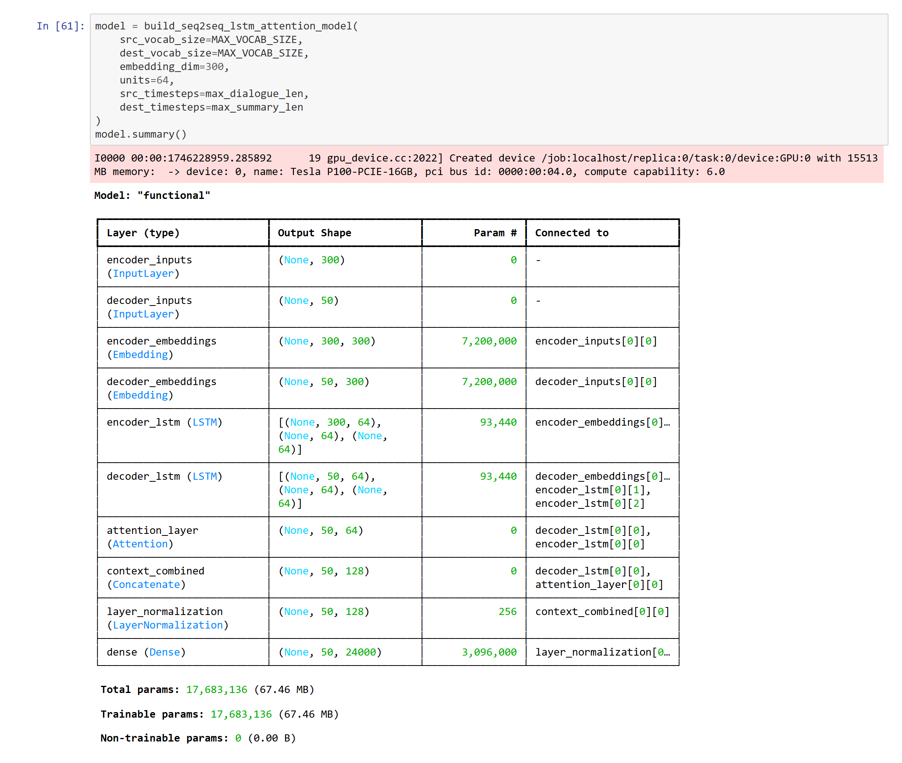
Model 1: Seq2Seq LSTM with Attention
Architecture
NOTEBOOK OUTPUT · MODEL.SUMMARY()
1
Embedding
300-dimensional vectors for a 24,000-word vocabulary
2
Encoder LSTM
64 units; processes the dialogue into hidden and cell states
3
Decoder LSTM
64 units; generates the summary from the encoder states
4
Attention
Aligns each decoder step with the relevant dialogue turns
5
Concatenate + LayerNorm
Merges attention context with the decoder output
6
Dense + Softmax
24,000-way softmax over the next summary token
17,683,136 trainable parameters across 21 layers (TensorFlow / Keras).
9

Slide 10
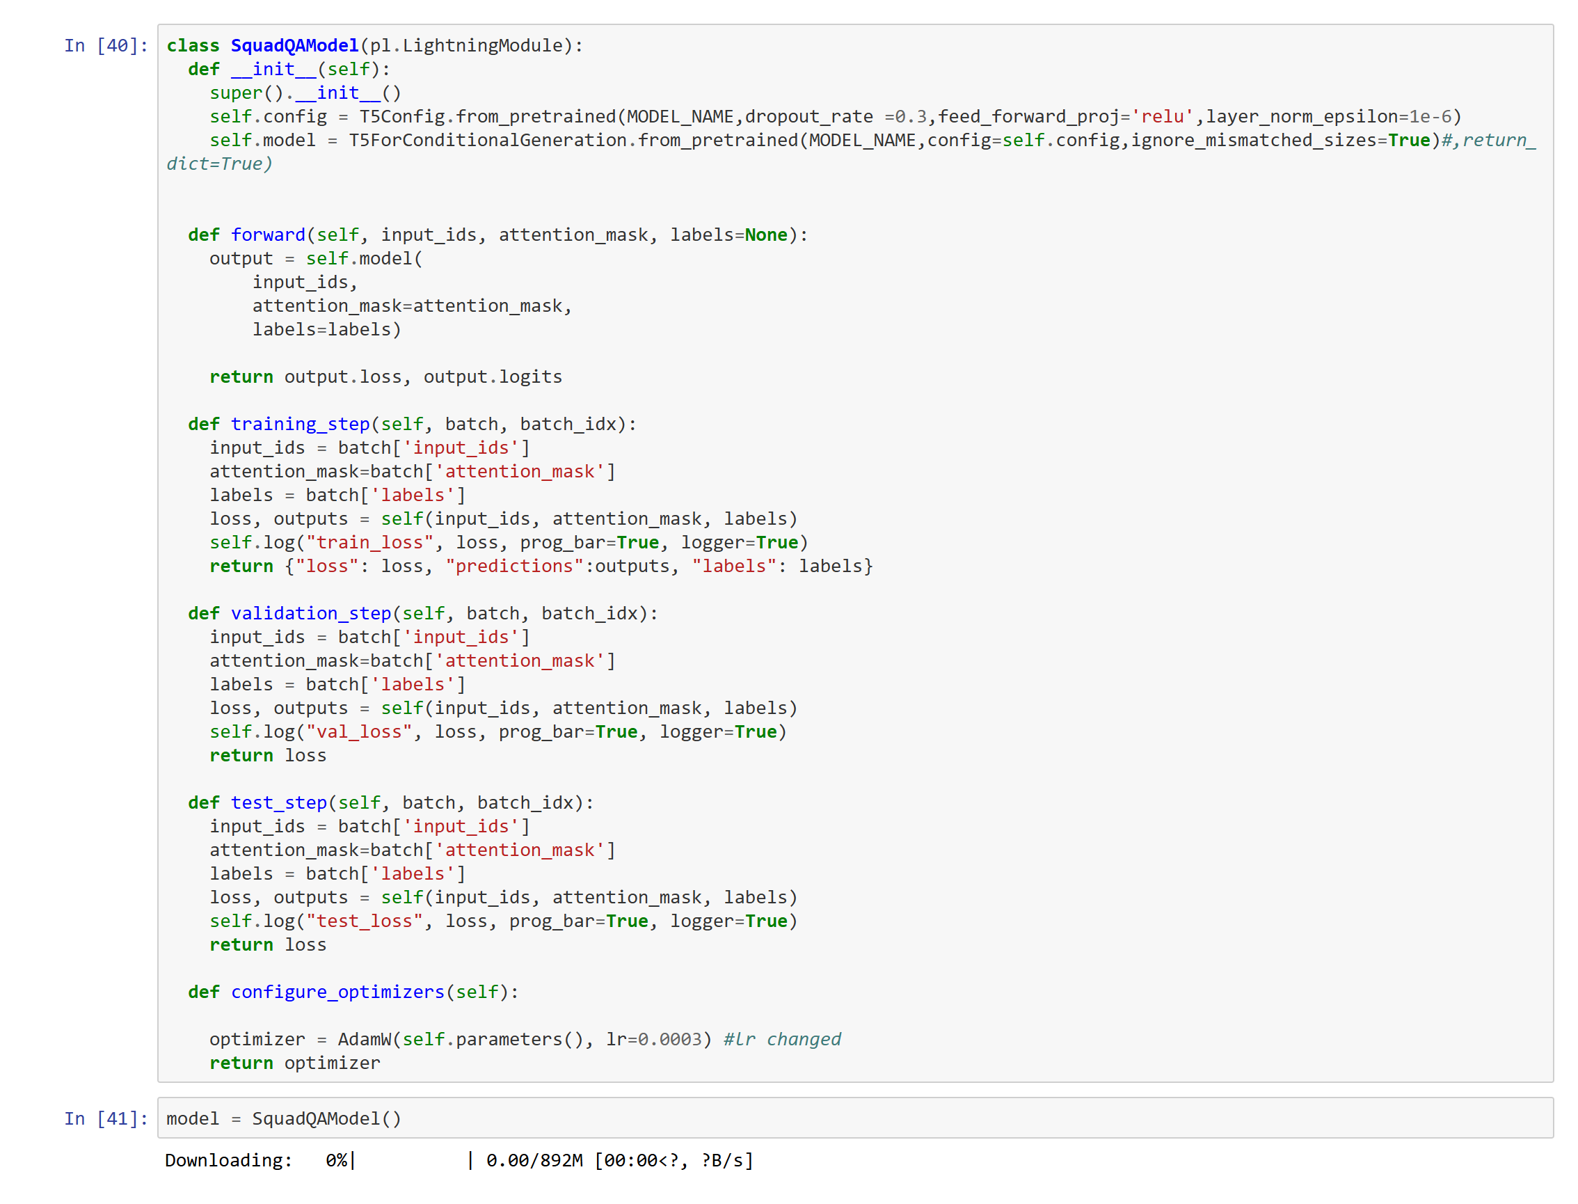
Model 2: T5-Base Transformer
T5-Base · Architecture
NOTEBOOK OUTPUT · T5 CONFIGURATION & LOADING
1
Input layer
Question and context converted into token IDs
2
Encoder
Builds contextual representations of the input
3
Decoder
Generates answer tokens from the encoder states
4
Output layer
Decodes generated tokens into readable text
Transfer learning
Pre-trained T5-Base weights fine-tuned on 5,000 SQuAD records with PyTorch Lightning, DataLoaders and a ModelCheckpoint callback.
t5-base loaded with its tokenizer and sequence-to-sequence head.
5,000
5
2
SQuAD records
training epochs
batch size
Fine-tuned end to end on the SQuAD training split.
10

Slide 11
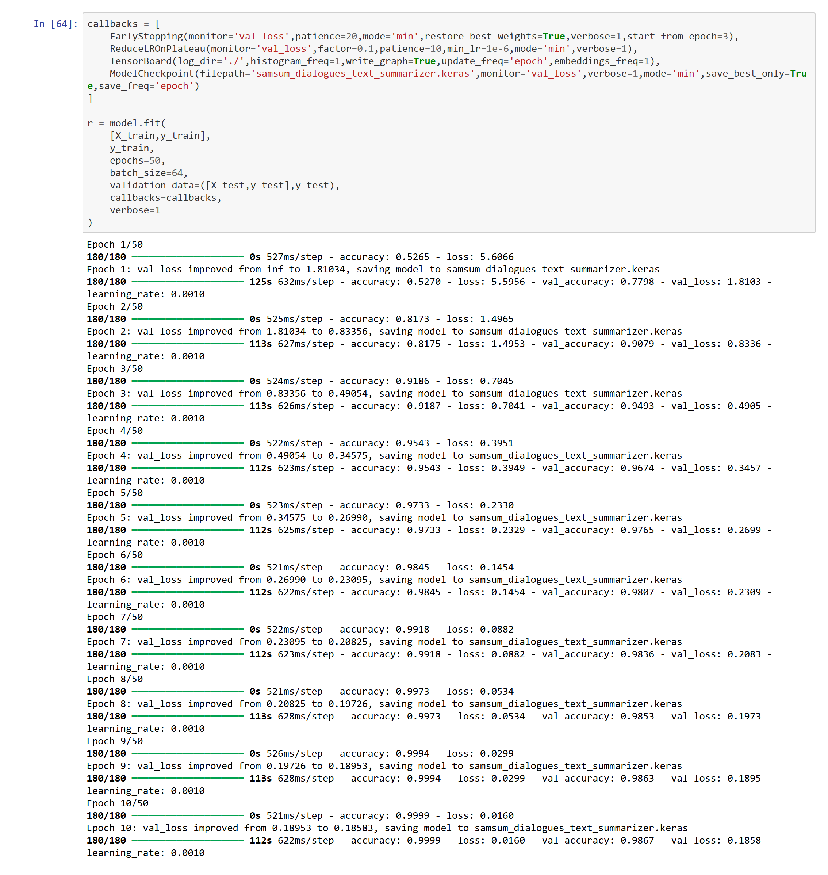
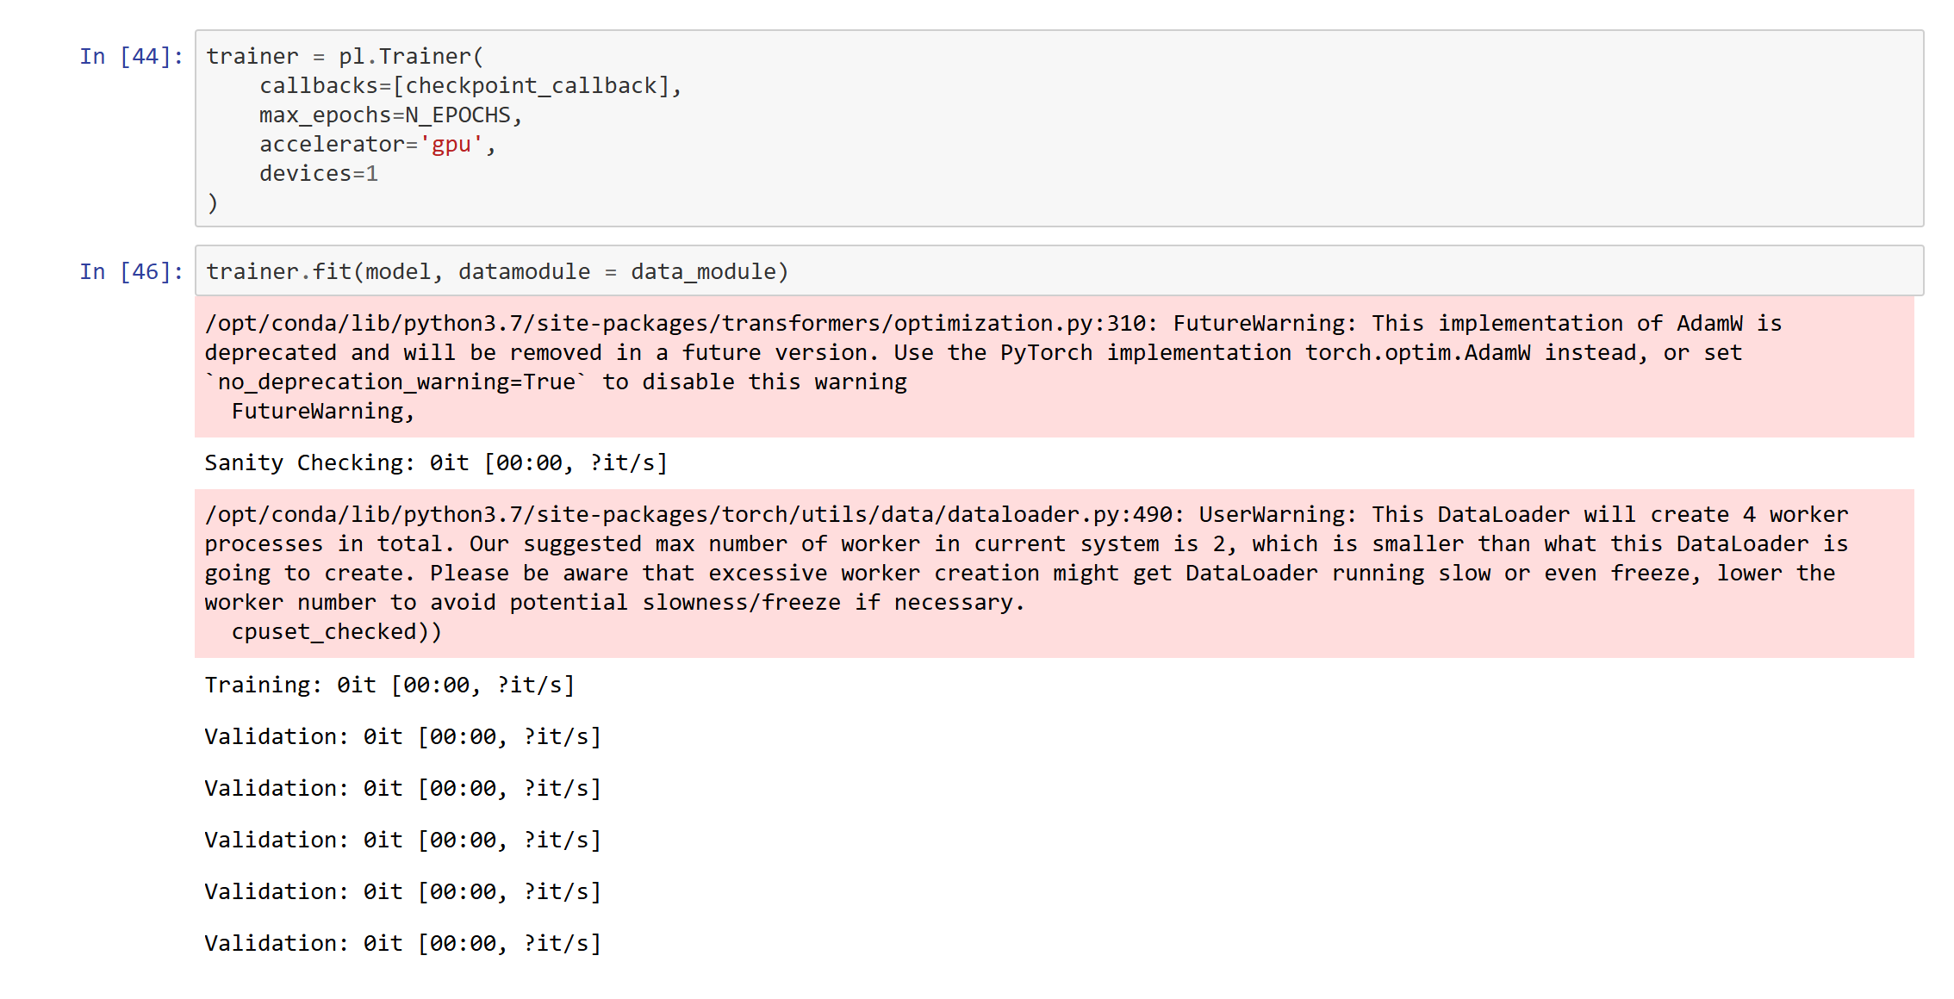
Model Training & Configuration
NOTEBOOK OUTPUT · LSTM TRAINING PROGRESS
Setting | LSTM | T5-Base
Framework | TF / Keras | PyTorch Lightning
Optimizer | Adam | AdamW
Learning rate | 0.001 (×0.1) | 0.0003
Batch size | 64 | 2
Epochs | ≤ 50, patience 20 | 5
Loss | Sparse CE | Val / test loss
Split | 70% / 30% | 3,800 / 200 / 1,000
NOTEBOOK OUTPUT · QA · TRAINER CONFIGURATION & FIT
Adam · lr 0.001 · batch 64 · early stopping at patience 20.
PyTorch Lightning · AdamW · lr 0.0003 · batch 2 · 5 epochs.
11

Slide 12
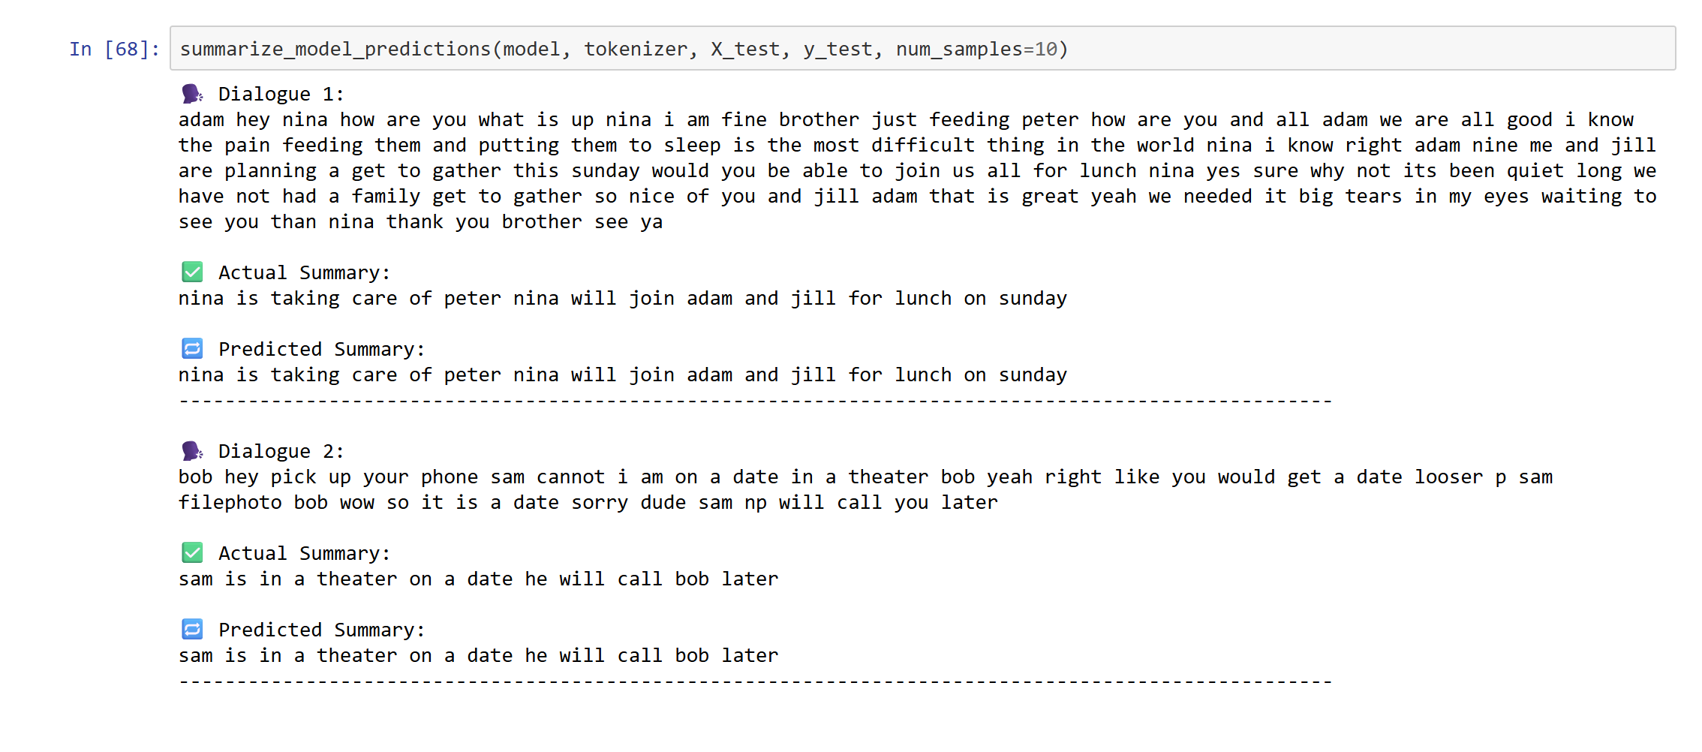
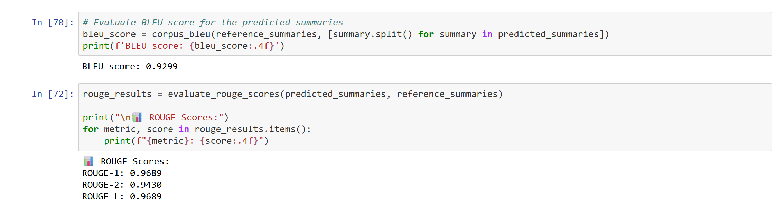
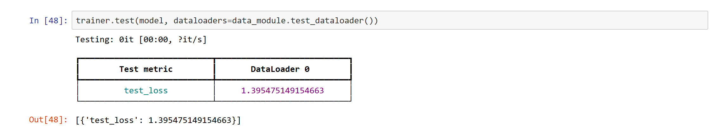
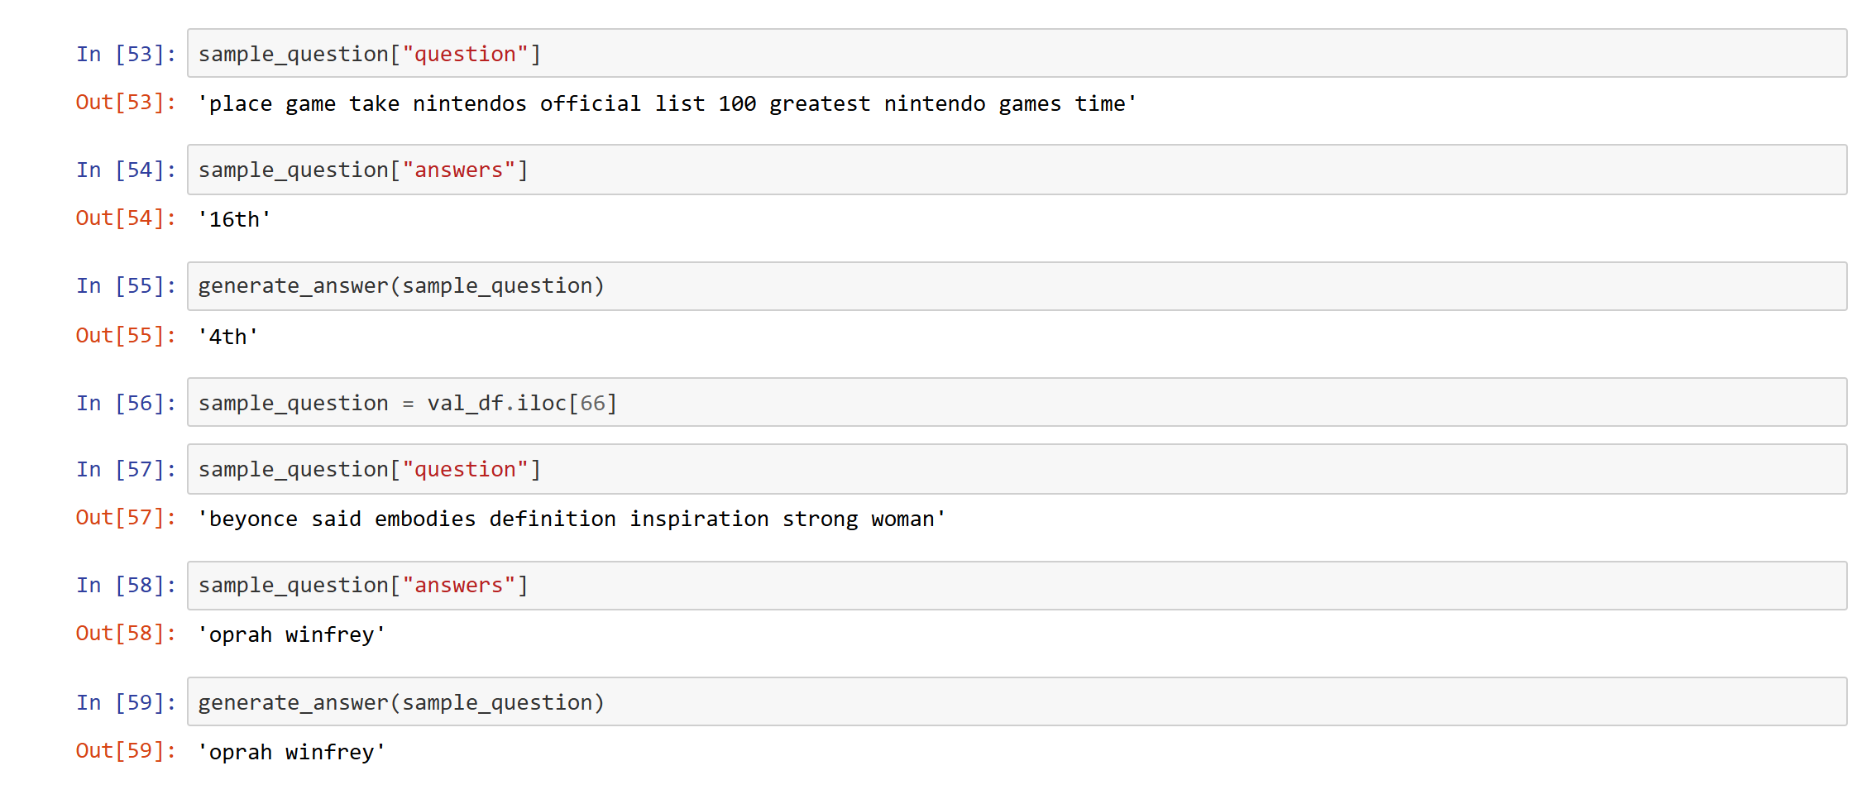
Performance Evaluation & Results
Summarisation · Predictions
0.9299
0.9689
1.3955
NOTEBOOK OUTPUT · REFERENCE VS GENERATED SUMMARY
BLEU
ROUGE-1
QA test loss
NOTEBOOK OUTPUT · BLEU & ROUGE
NOTEBOOK OUTPUT · QA TEST LOSS
Question Answering · Predictions
NOTEBOOK OUTPUT · QUESTIONS, EXPECTED ANSWERS & PREDICTIONS
Interpretation & Caveats
Teacher forcing was used: the reference summary is fed to the decoder.
The test split also served as validation, so scores may be optimistic.
QA is reported by test loss only; Exact Match and F1 are not yet computed.
12

Slide 13
Limitations, GUI & Next Steps
Evaluation limitations
Next steps
Summarisation: scores were computed with teacher forcing (reference summary supplied to the decoder)
The test split also served as validation data, which may inflate scores
QA: Exact Match and F1 have not yet been computed
Evaluate on an independent test set with autoregressive decoding and re-report BLEU / ROUGE
Add Exact Match and F1 evaluation for QA
Confirm the summarisation dataset source and loading procedure
Develop the user interface and a live demonstration
Planned GUI and demonstration flow
Open the app
›
Enter dialogue, or question + context
›
Click Summarise / Generate Answer
›
Backend preprocesses text
›
Trained model runs
›
Summary or answer shown
The graphical interface (input area, action button, progress indicator, output area) is the next development step; the notebooks currently contain model and inference code only.
13

Slide 14
Conclusion & Future Scope
Conclusion
Two NLP systems were developed end to end: an LSTM + Attention summariser and a fine-tuned T5-Base question-answering model.
Both cover preprocessing, feature engineering, training and evaluation, and provide a foundation for educational and professional tools. Evaluation remains preliminary.
Making lengthy text shorter, smarter and easier to use.
Future scope
Transformer models: BART or T5 for summarisation; T5-Large for QA
1
Speech-to-text: automatic transcription of lectures and meetings
2
Multilingual support: Indian and international languages
3
Web application: document upload (PDF, Word, transcripts) with real-time results
4
Key-point extraction: decisions, action items, deadlines and speaker identification
0.969
ROUGE-1 (preliminary)
1.3955
QA test loss
5
Export & search: PDF export, multi-document QA and document search
6
14

Slide 15
THANK YOU
Meeting/Lecture Summarisation & Question Answering Systems
Questions and Discussion
Department of Computer Science and Engineering (AI & ML) | K.R. Mangalam University

